Slide 1
Load, Copy & Save Image using Python
Imanuel Ronaldo/ 2103161044

Slide 2
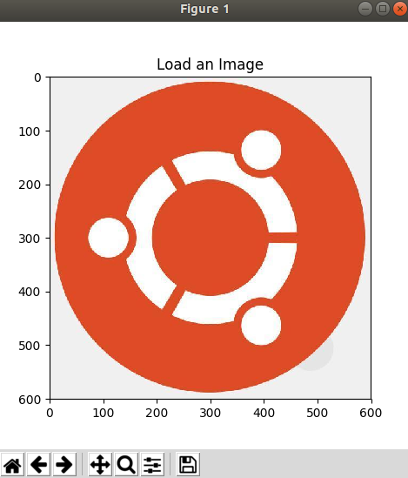
Load Image
import numpy as np
import matplotlib.pyplot as plt
import imageio
img = imageio.imread("ubuntu.jpg")
img_height = img.shape[0]
img_width = img.shape[1]
img_channel = img.shape[2]
plt.imshow(img)
plt.title("Load an Image")
plt.show()

Slide 3
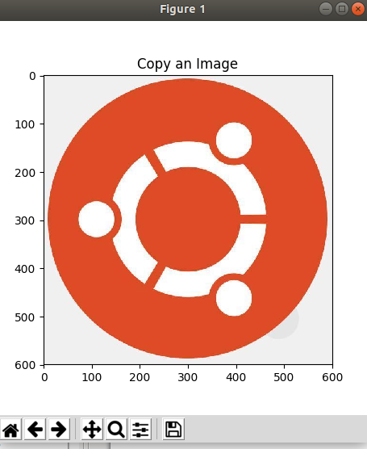
Copy Image
import numpy as np
import matplotlib.pyplot as plt
import imageio
img = imageio.imread("ubuntu.jpg")
img_height = img.shape[0]
img_width = img.shape[1]
img_channel = img.shape[2]
img_copy = np.zeros(img.shape, img.dtype)
for y in range(0, img_height):
for x in range(0, img_width):
for c in range(0, img_channel):
img_copy[y][x][c]=img[y][x][c]
plt.imshow(img_copy)
plt.title("Copy an Image")
#plt.imsave("saved-copy-nuel.jpg",img_copy)
plt.show()

Slide 4
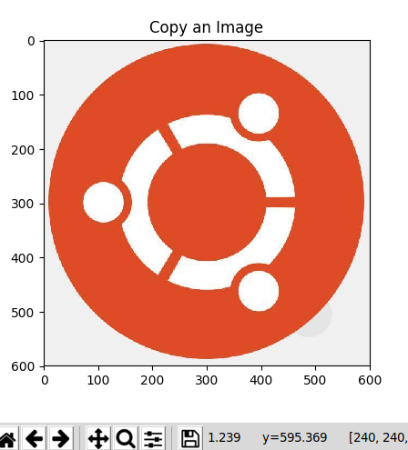
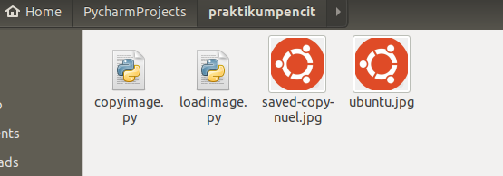
Save Image
import numpy as np
import matplotlib.pyplot as plt
import imageio
img = imageio.imread("ubuntu.jpg")
img_height = img.shape[0]
img_width = img.shape[1]
img_channel = img.shape[2]
img_copy = np.zeros(img.shape, img.dtype)
for y in range(0, img_height):
for x in range(0, img_width):
for c in range(0, img_channel):
img_copy[y][x][c]=img[y][x][c]
plt.imshow(img_copy)
plt.title("Copy an Image")
#plt.imsave("saved-copy-nuel.jpg",img_copy)
plt.show()

